Slide 1


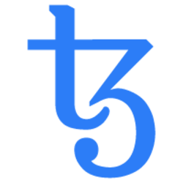
Audious
01

Slide 2
Problem statement
Music is known to be effective for mood improvement.
It has the power to change ones overall frame of mind.
Music also plays a very big role in changing the atmosphere and influencing the ambience of any place.

Slide 3

Why This Problem Statement?

Slide 4

De-fi Music App with NFTs
A project by –Kartik Jolapara –Greha Shah –Neel –Sharvari joshi

Slide 5

Our Main Features
Mood detection
Smart contracts through NFTs
Chat Bot

Slide 6
Why this topic is very relevant?

Slide 7

Features
Mood detection Using live camera the ai/ml model generates music
Smart contracts through NFTs
Chat Bot

Slide 8
Basic Utility
1
2
Play any song on the blockchain
Create playlists for the songs and then listen to them

Slide 9
You don’t always have to build engagement, might as well buy it.

Slide 10
Potential in the future
Implement CRUD
Videos addition
Rolyalty for artist
Search algorithm
Currently only Reading is available
Like audios we can add videos with it
Of socials on the website itself
With using fuzzy search package

Slide 11
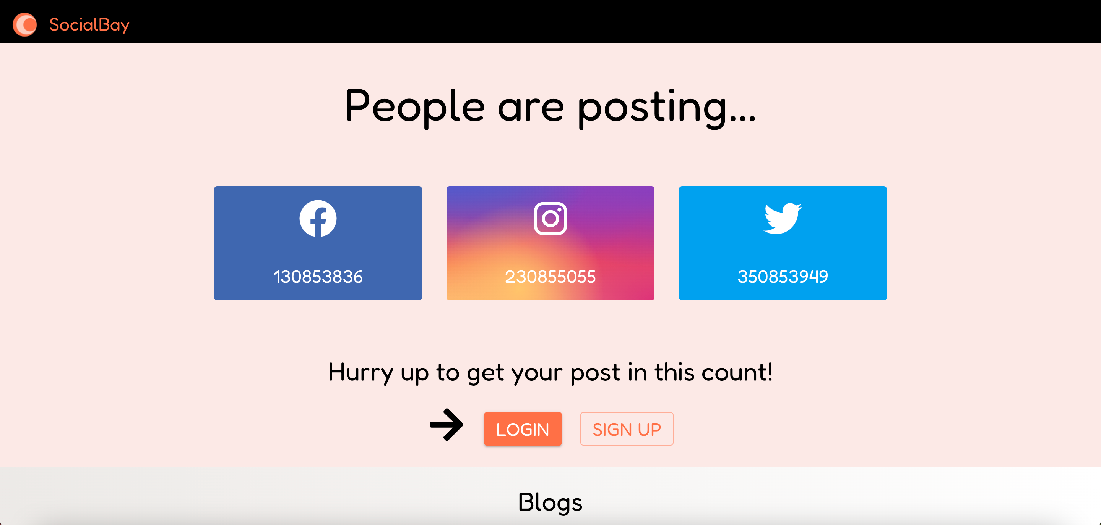

Slide 12
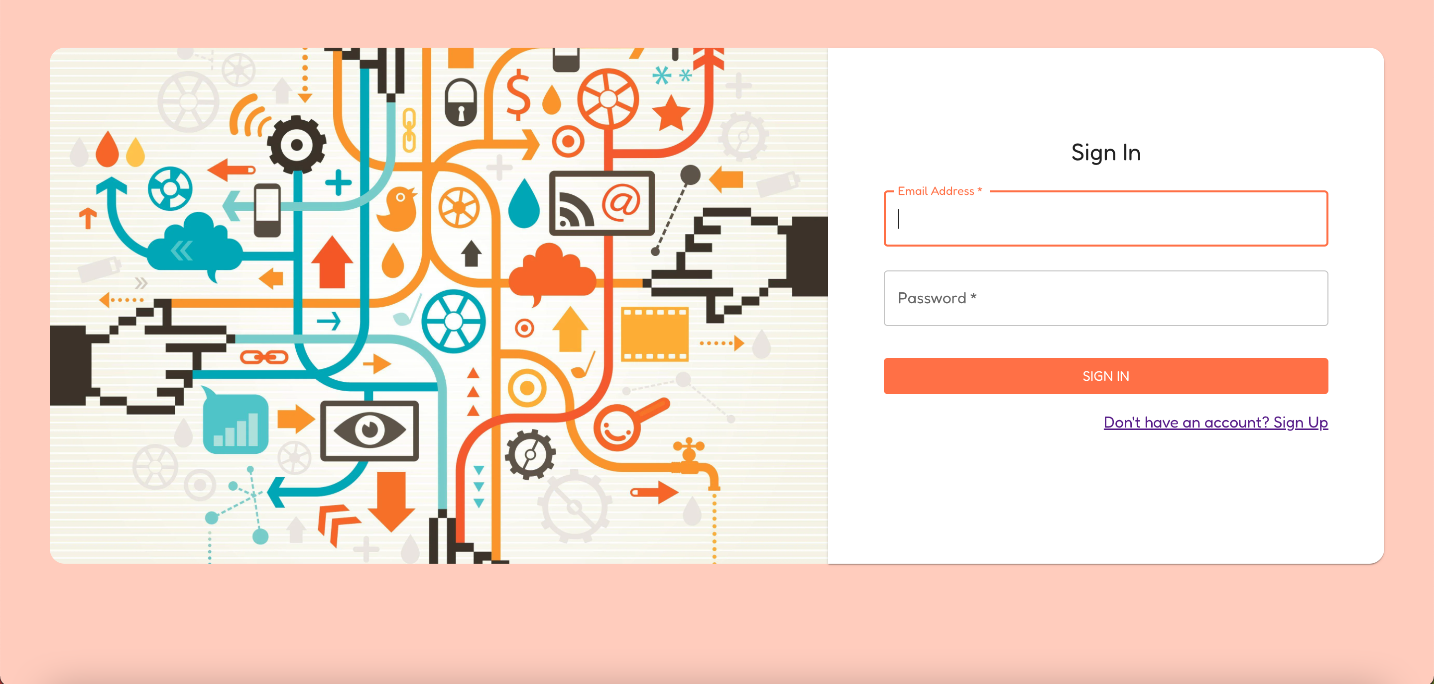

Slide 13
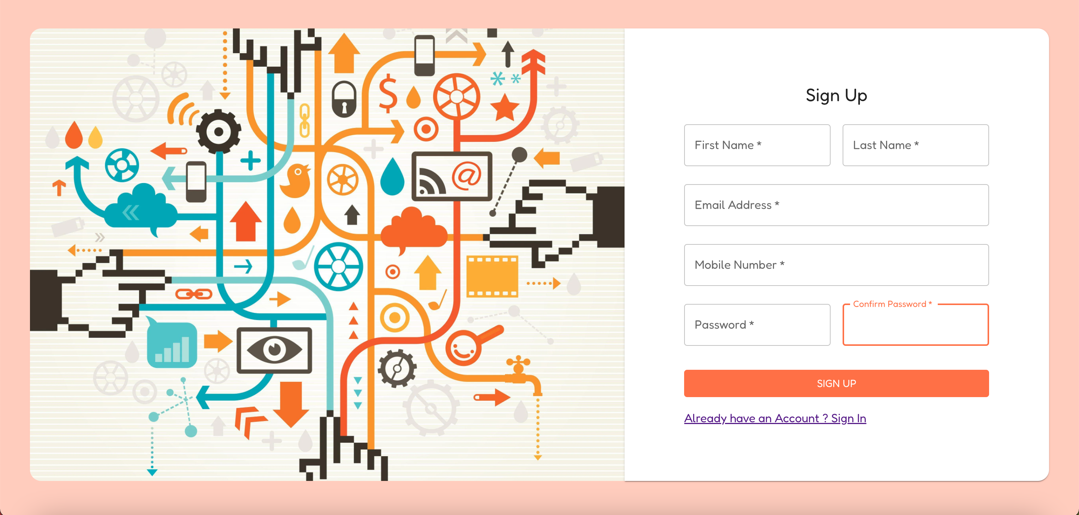

Slide 14
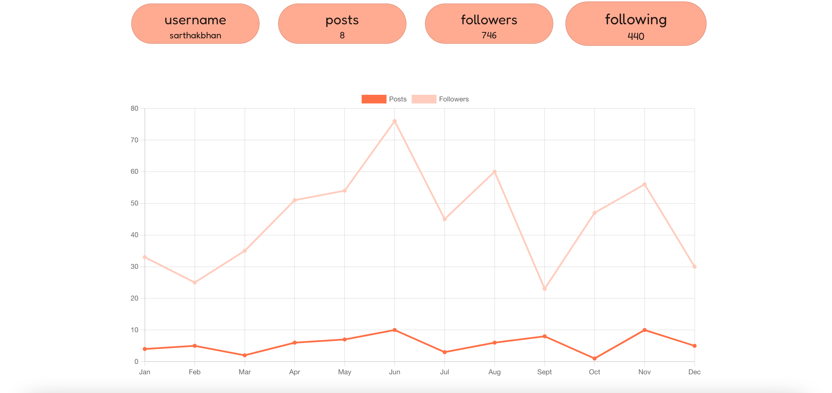

Slide 15
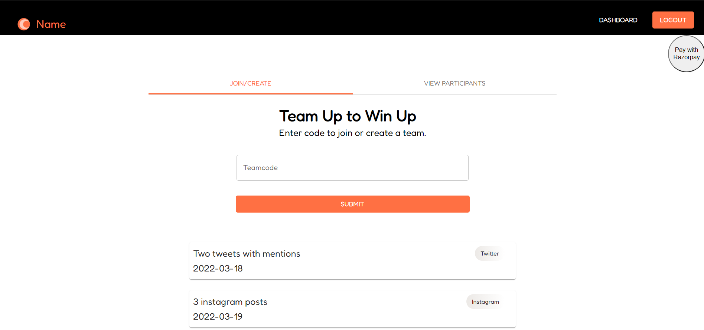

Slide 16
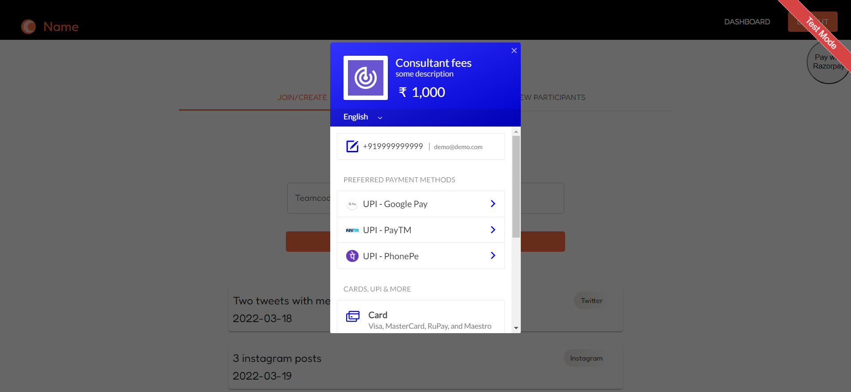

Slide 17
Thank you!
We hope to take this project to the next level

